Slide 1
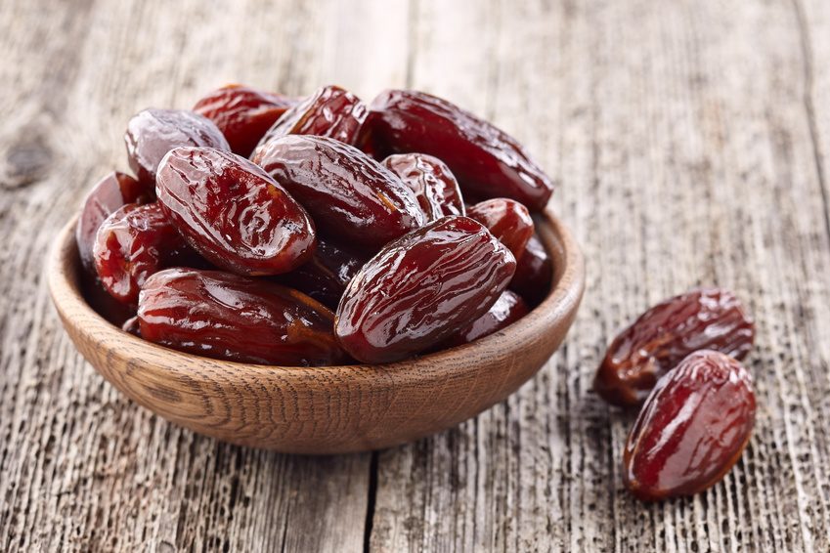
Dates (Tamer) Project

Slide 2
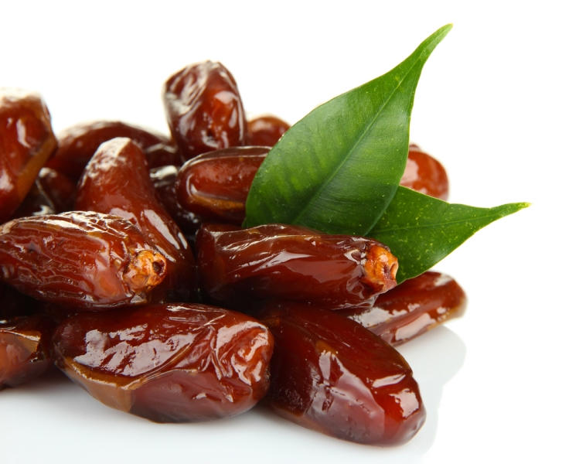
Problem
In the Saudi market we have many public dates markets to buy from, only we are facing problems such as:
The overstocking of dates in the markets, leading the merchants to sell consumers dates from last seasons.
Consumers have to rely on the merchant words regarding the dates.

Slide 3
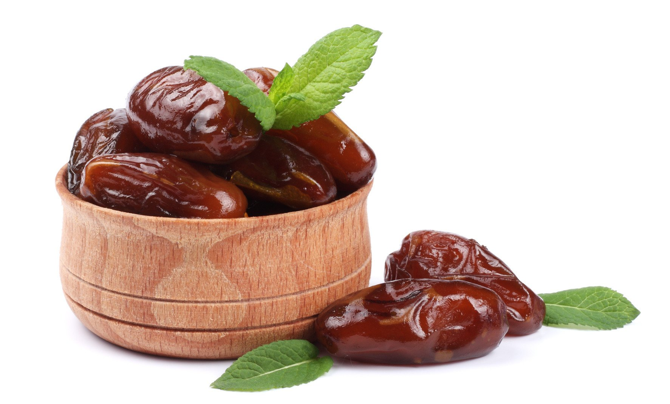
Vision
To solve the trusting in merchants only problem the customer has.
Giveing them all the information regarding dates before buying.
Better Buying experience to the consumer throughout new technology solution.

Slide 4
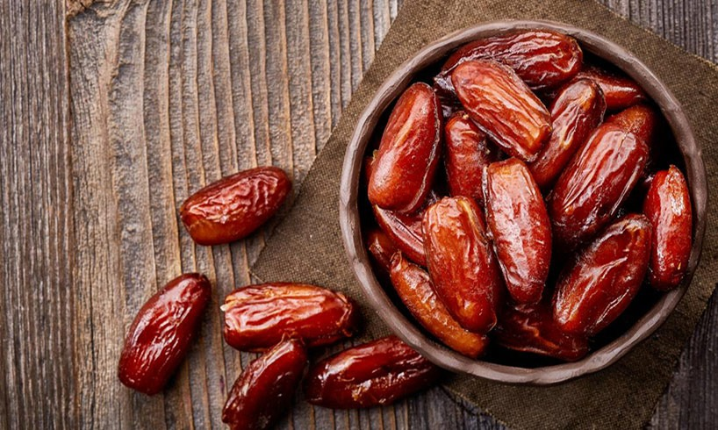
Value Proposition
We created new Blockchain solution to introduce in the market since there is no such tech was introduced before.
We created it to help the consumers in getting all the important information regarding dates, like: (from where it came, “ Tamer type” and when it was produced without the merchant involvement in the process.

Slide 5
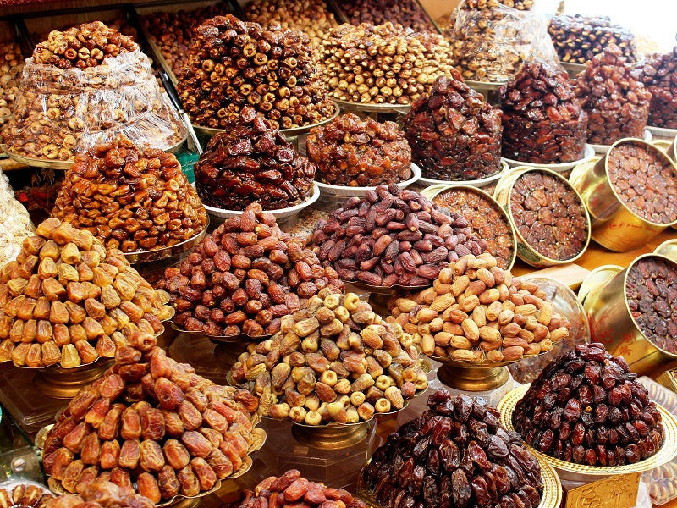
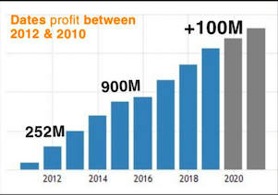
Saudi Dates Market
The produced Dates yearly is 1.539.755 ton which equal to 17% globally.
Dates market keeps extending and we aim to increase it further in the future.
Chart is showing dates profit from local markets and factores only.
Reaching those who wasn't reached before to catch 1% of 17% market equals to 10M SAR approximately.

Slide 6
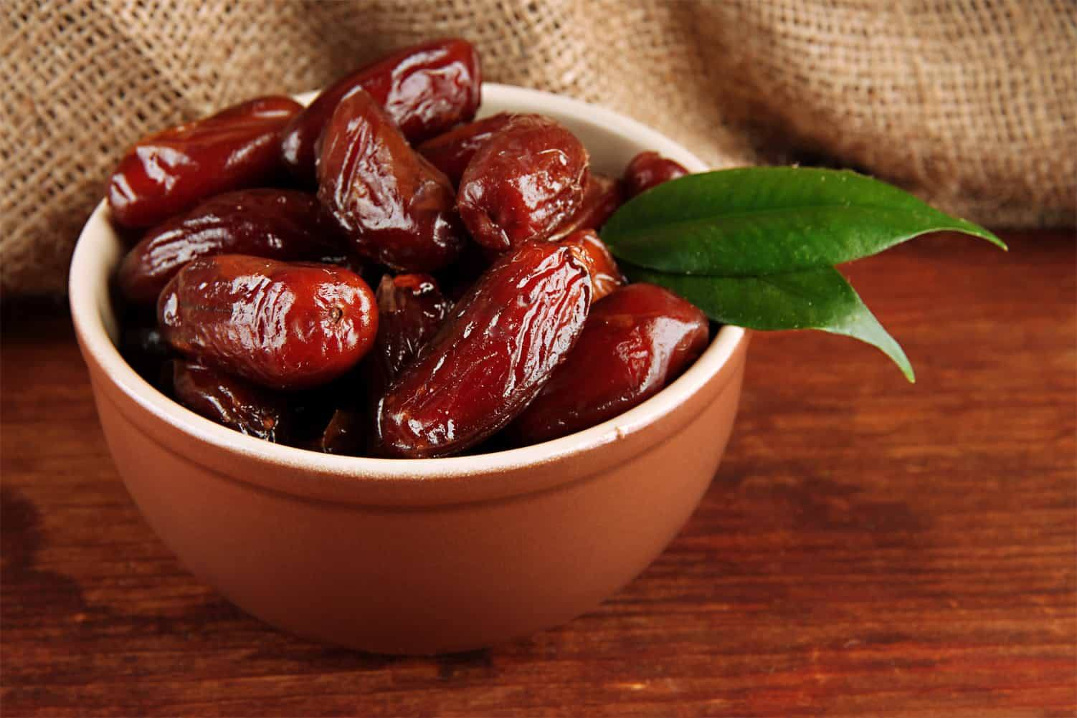
Young consumers with no experience regarding good dates.
Visitors: Musilims who come to visit the kingdom for Islimic proposes like: Umrah and Hajj every year.
Resident workers and their families.
Target Customer

Slide 7
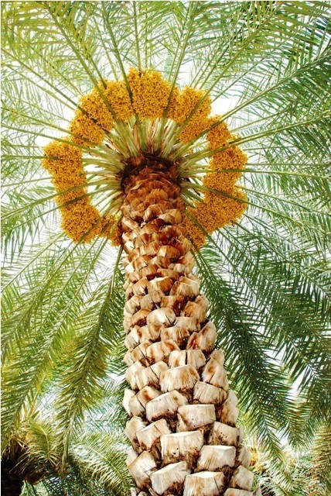
Competition
Our competitors:
Riyadh Season Dates Market: (https://riyadh-tours.com/riyadh-seasonal-dates-market/ ) In Riyadh, “Al Rabwah market” is one of the main dates markets every year.
Atayeb Al Tumor: Good quality dates, different options and cheap price have 15 years experience.
Riyadh dates factory: (https://www.riyadhdatesfactory.com/)“ have more than 25 years of experience in sourcing the finest date products in the region through quality control system and administrative protocols”.
Kingdom Dates: (https://kingdomdates.com.sa/) Established in 1987 in Saudi Arabia to provide the local market with high quality.

Slide 8
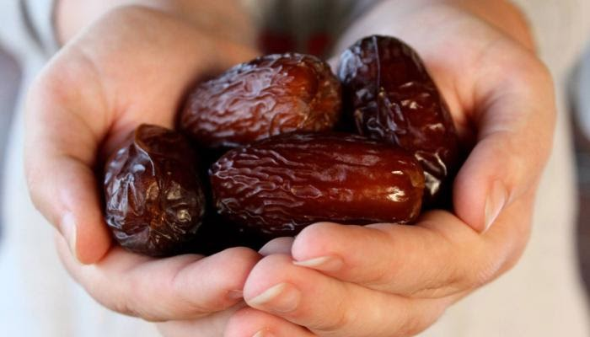
Business Model
Key Partners:
Farmer contacts the consumer throughout the blockchain network.
Dates “Tamer” information added by farmer only.
Merchant have no authority to change information.
What we are solving?
Consumer lack of knowledge.
Consumer trust.
Key Activities:
Creating trust among consumers by providing them information like (location, DOP, DOE).
Letting them know that the farmer is the only person authorized to enter the data.

Slide 9
Business Model
The Key Resources:
Investors.
Developers creating the blockchain network.
Metadata entered by the Farmers.
On foot workers moving around the farms to reach farmers.
Trained Merchants to tell consumers about the new tech.
Customer Relationships:
Building strong relationship comes with insuring the network itself for consumers and making it easy to reach at anytime.
Channels:
Website link.

Slide 10
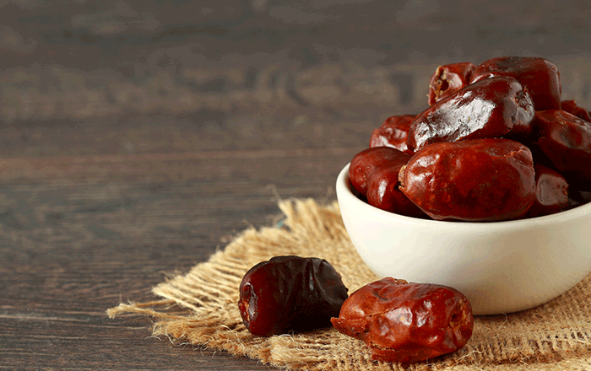
Business Model
Customer Segments:
The young inexperienced consumers “ the elder consumer are way experienced since most of them grew up in farms or raised by farmers.
Cost Structure:
Creating Blockchain network.
Salaries ( developers, on foot workers).
Rents, Utilities and transportation.
Revenue Streams:
Collecting subscription fee from farmers to use the blockchain network.
Take sales percentage from merchants.

Slide 11
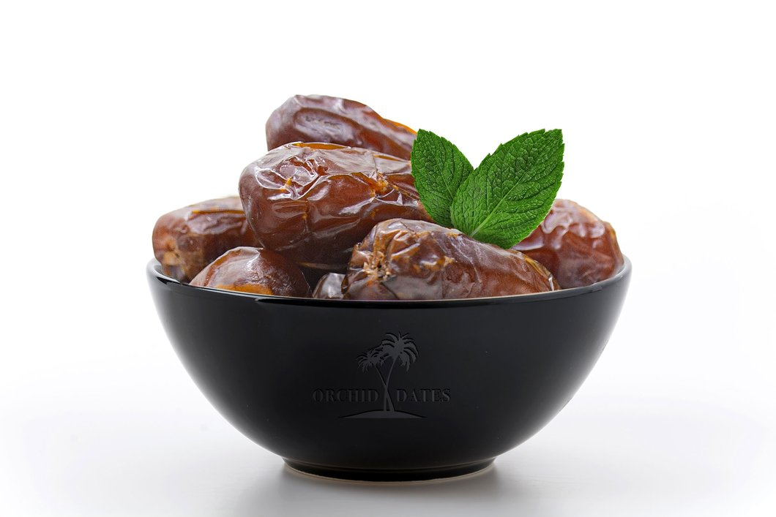
Benefits of Presented Solution
Preventing Fraud (How)?
The merchant can keep dates until he is out of stock since dates validity goes up to months.
Connecting the consumer with the farmer metadata to rest him regarding the DOP.
Farmer will give right information because he wants to sell his harvest every season and its not in his best interest to give false information.

Slide 12






Accountability Through Blockchain
01
Self-honesty
Establishing recorder of accountability since we don't have centralized data system.
Creating a record of accountability to insure farmer from entering false data.
Consumers can follow with us in case they had bad experience using the blockchain.
02
Value others
03
Keep records
Steps to Accountability
04
Take responsibility
05
Do the right thing
06
Act promptly with care

Slide 13
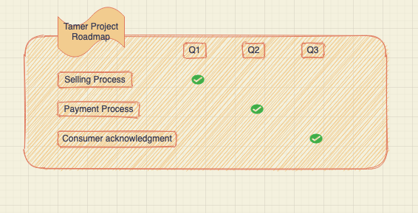
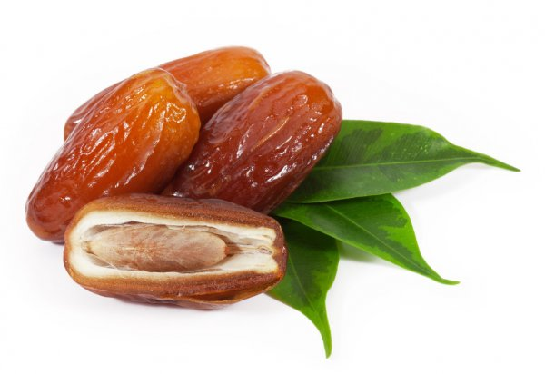
Roadmap

Slide 14
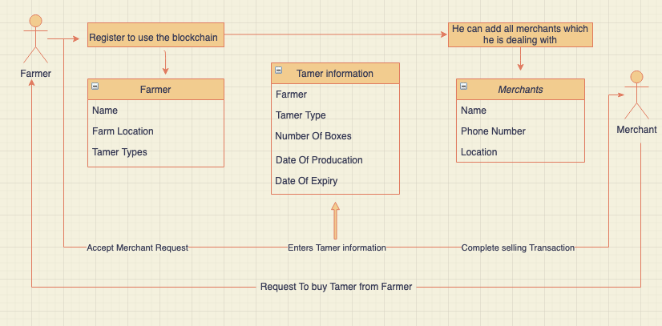
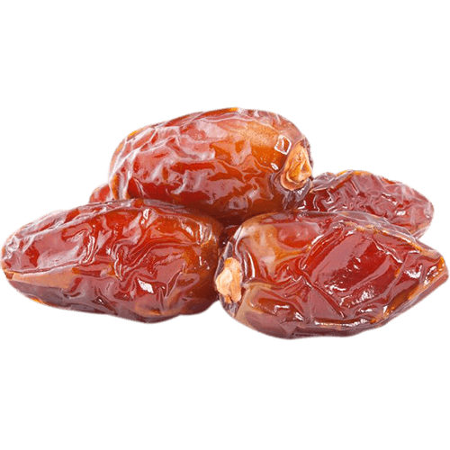
UML Diagram

Slide 15
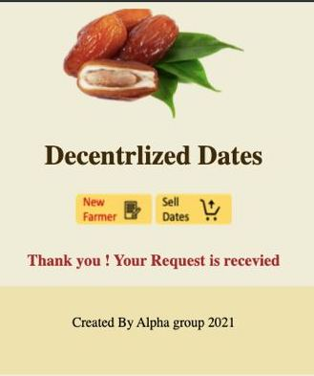
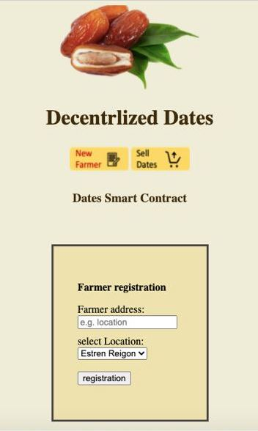
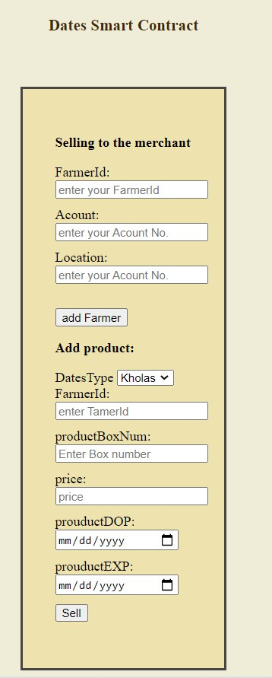
Demo/solution

Slide 16
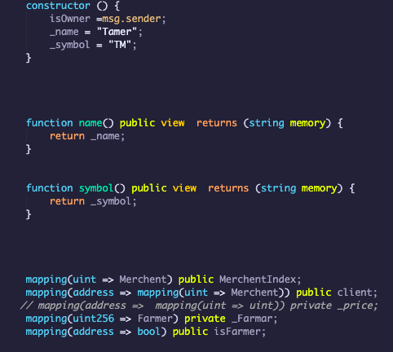
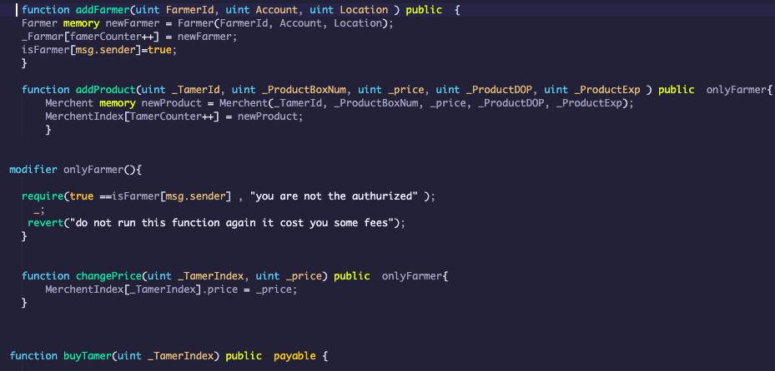
Some Code Function

Slide 17
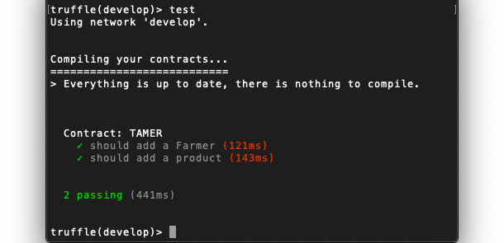
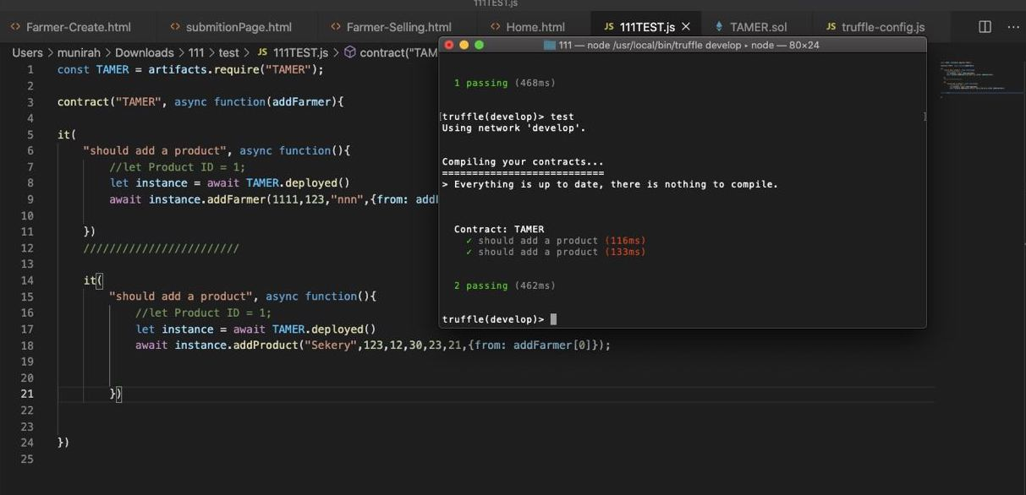
Test

Slide 18





Abdulrahman: Project Manager. can manage project progress and adapt work as required.also, Ensuring projects meet deadlines.
Abeer: Developer. can Develop new applications.Utilize programming principles, tools, and techniques to write application codes.
Ammar: CTO.Ensuring technologies currently in use are efficient and making changes wherever necessary.
Ghadeer: CEO. can make important major decisions, managing the overall operations and resources, communicating, on behalf of all.
Munirah: Design. can design and determine requirements Ensure final graphics and layouts are visually appealing.
Team Alpha

Slide 19
THANK YOU!
For Your Time

